Slide 1
Computer Networks
Prabhu Subramanian
prabhus@wilp.bits-pilani.ac.in

Slide 2

IMP Note to Self

Slide 3
Important Note to Students
It is important to know that just login to the session does not guarantee the attendance.
Once you join the session, continue till the end to consider you as present in the class.
IMPORTANTLY, you need to make the class more interactive by responding to Professors queries in the session.
Whenever Professor calls your number / name, you need to respond, otherwise it will be considered as ABSENT

Slide 4
SEWI ZC467 - COMPUTER NETWORKS
Lecture No. 07

Slide 5
Flow Control vs Congestion Control
Traffic-controlling methods for different situations.
In flow control, the rate of traffic received from a sender can be controlled by a receiver.
Flow control is a technique used to regulate the flow of data between different nodes in a network. It ensures that a sender does not overwhelm a receiver with too much data too quickly.
The goal of flow control is to prevent buffer overflow, which can lead to dropped packets and poor network performance.

Slide 6
Flow Control vs Congestion Control
Traffic-controlling methods for different situations.
In congestion control, the rate of traffic from the sender to the network is controlled.
Congestion control is a technique used to prevent congestion in a network.
Congestion occurs when too much data is being sent over a network, and the network becomes overloaded, leading to dropped packets and poor network performance.

Slide 7
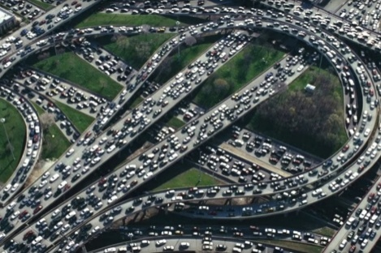


Principles of congestion control
Congestion:
informally: “too many sources sending too much data too fast for network to handle”
manifestations:
  long delays (queueing in router buffers)
  packet loss (buffer overflow at routers)
different from flow control!
congestion control: too many senders, sending too fast
a top-10 problem!
flow control: one sender too fast for one receiver

Slide 8

Causes/costs of congestion: scenario 1
original data: λ_{in}
throughput: λ_{out}
Simplest scenario:
Host A
one router, infinite buffers
input, output link capacity: R
infinite shared output link buffers
two flows
R
R
no retransmissions needed
Host B
R/2
Q: What happens as arrival rate λ_{in} approaches R/2?
λ_{out}
delay
throughput:
λ_{in}
R/2
λ_{in}
R/2
maximum per-connection throughput: R/2
large delays as arrival rate λινε approaches capacity

Slide 9

Causes/costs of congestion: scenario 2
one router, finite buffers
sender retransmits lost, timed-out packet
  application-layer input = application-layer output: λ_{in} = λ_{out}
  transport-layer input includes retransmissions : λ’_{in} λ_{in}
Host A
λ_{in} : original data
λ'_{in}: original data, plus retransmitted data
λ_{out}
R
R
Host B
finite shared output link buffers

Slide 10
Causes/costs of congestion: scenario 2
R/2
Idealization: perfect knowledge
sender sends only when router buffers available
λ_{out}
throughput:
Host A
λ_{in} : original data
λ_{in}
copy
λ'_{in}: original data, plus retransmitted data
λ_{out}
R/2
free buffer space!
R
R
Host B
finite shared output link buffers

Slide 11

Causes/costs of congestion: scenario 2
Idealization: some perfect knowledge
packets can be lost (dropped at router) due to full buffers
sender knows when packet has been dropped: only resends if packet known to be lost
Host A
λ_{in} : original data
copy
λ'_{in}: original data, plus retransmitted data
no buffer space!
R
R
Host B
finite shared output link buffers

Slide 12
Causes/costs of congestion: scenario 2
Idealization: some perfect knowledge
packets can be lost (dropped at router) due to full buffers
sender knows when packet has been dropped: only resends if packet known to be lost
R/2
“wasted” capacity due to retransmissions
λ_{out}
when sending at R/2, some packets are needed retransmissions
throughput:
Host A
λ_{in} : original data
λ_{in}
λ'_{in}: original data, plus retransmitted data
R/2
free buffer space!
R
R
Host B
finite shared output link buffers

Slide 13


Causes/costs of congestion: scenario 2
Realistic scenario: un-needed duplicates
packets can be lost, dropped at router due to full buffers – requiring retransmissions
but sender times can time out prematurely, sending two copies, both of which are delivered
R/2
λ_{out}
“wasted” capacity due to un-needed retransmissions
throughput:
when sending at R/2, some packets are retransmissions, including needed and un-needed duplicates, that are delivered!
Host A
λ_{in} : original data
λ_{in}
copy
λ'_{in}: original data, plus retransmitted data
R/2
timeout
free buffer space!
R
R
Host B
finite shared output link buffers

Slide 14
Causes/costs of congestion: scenario 2
R/2
Realistic scenario: un-needed duplicates
packets can be lost, dropped at router due to full buffers – requiring retransmissions
but sender times can time out prematurely, sending two copies, both of which are delivered
λ_{out}
“wasted” capacity due to un-needed retransmissions
throughput:
when sending at R/2, some packets are retransmissions, including needed and un-needed duplicates, that are delivered!
λ_{in}
R/2
“costs” of congestion:
more work (retransmission) for given receiver throughput
unneeded retransmissions: link carries multiple copies of a packet
  decreasing maximum achievable throughput

Slide 15
Causes/costs of congestion: scenario 3
four senders
multi-hop paths
timeout/retransmit
Q: what happens as λ_{in} and λ_{in}’ increase ?
A: as red λ_{in}’ increases, all arriving blue pkts at upper queue are dropped, blue throughput g 0
Host A
λ_{in} : original data
λ'_{in}: original data, plus retransmitted data
Host B
finite shared output link buffers
Host D
λ_{out}
Host C

Slide 16
Causes/costs of congestion: scenario 3
R/2
λ_{out}
λ_{in}’
R/2
another “cost” of congestion:
when packet dropped, any upstream transmission capacity and buffering used for that packet was wasted!

Slide 17
Causes/costs of congestion: insights
throughput can never exceed capacity
delay increases as capacity approached
loss/retransmission decreases effective throughput
un-needed duplicates further decreases effective throughput
upstream transmission capacity / buffering wasted for packets lost downstream

Slide 18
Approaches towards congestion control
End-end congestion control:
no explicit feedback from network layer
congestion inferred from observed loss, delay
ACKs
data
data
ACKs
approach taken by TCP
Choke Packet

Slide 19
Approaches towards congestion control
Network-assisted congestion control:
routers provide direct feedback to sending/receiving hosts with flows passing through congested router
may indicate congestion level or explicitly set sending rate
explicit congestion info
ACKs
data
data
ACKs
ECN - Explicit Congestion Notification
ATM - Asynchronous Transfer Mode
DECbit - Decreasing Bit-rate
TCP ECN, ATM, DECbit protocols

Slide 20
TCP congestion control: AIMD
(Additive Increase Multiplicative Decrease)
additively increase window size …
…. until loss occurs (then cut window in half)
AIMD saw tooth
behavior: probing
for bandwidth
cwnd: TCP sender
congestion window size
time

Slide 21
TCP congestion control: AIMD
(Additive Increase Multiplicative Decrease)
approach: senders can increase sending rate until packet loss (congestion) occurs, then decrease sending rate on loss event
Additive Increase
Multiplicative Decrease
  increase sending rate by 1 maximum segment size every RTT until loss detected
  cut sending rate in half at each loss event
AIMD sawtooth
behavior: probing
for bandwidth
TCP sender Sending rate
time

Slide 22
TCP congestion control: details
sender sequence number space
TCP sending behavior:
roughly: send cwnd bytes, wait RTT for ACKS, then send more bytes
cwnd
last byte
ACKed
cwnd
sent, but not-yet ACKed
(“in-flight”)
available but not used
TCP rate
~
bytes/sec
~
RTT
last byte sent
TCP sender limits transmission:
cwnd is dynamically adjusted in response to observed network congestion (implementing TCP congestion control)
<
cwnd
LastByteSent- LastByteAcked

Slide 23

TCP slow start
Host A
Host B
when connection begins, increase rate exponentially until first loss event:
  initially cwnd = 1 MSS
  double cwnd every RTT
  done by incrementing cwnd for every ACK received
one segment
RTT
two segments
four segments
summary: initial rate is slow, but ramps up exponentially fast
time

Slide 24
TCP: detecting, reacting to loss
loss indicated by timeout:
  cwnd set to 1 MSS;
  window then grows exponentially (as in slow start) to threshold, then grows linearly
loss indicated by 3 duplicate ACKs: TCP RENO
  dup ACKs indicate network capable of delivering some segments
  cwnd is cut in half window then grows linearly
TCP Tahoe always sets cwnd to 1 (timeout or 3 duplicate acks)
TCP Tahoe = Slow Start + AIMD + Fast Retransmit
TCP Reno = TCP Tahoe + Fast Recovery

Slide 25
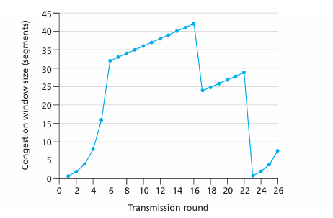
Consider the below figure. Assuming TCPReno is the protocol experiencing the behavior shown above, answer the following questions. In all cases, you should provide a short discussion justifying your answer.

Slide 26
  Identify the intervals of time when TCPslow start is operating.
  Identify the intervals of time when TCPcongestion avoidance is operating.
  After the 16th transmission round, is segment loss detected by a triple duplicate ACK or by a timeout?
  After the 22nd transmission round, is segment loss detected by a triple duplicate ACK or by a timeout?
  What is the initial value of ssthreshat the first transmission round?
  What is the value of ssthreshat the 18th transmission round?
  What is the value of ssthreshat the 24th transmission round?
  During what transmission round is the 70th segment sent?
  Assuming a packet loss is detected after the 26th round by the receipt of a triple duplicate ACK, what will be the values of the congestion window size and of ssthresh?
  Suppose TCP Tahoe is used (instead of TCP Reno), and assume that triple duplicate ACKs are received at the 16th round. What are the ssthresh and the congestion window size at the 19th round?
  Again suppose TCP Tahoe is used, and there is a timeout event at 22nd round. How many packets have been sent out from 17th round till 22nd round, inclusive?

Slide 27
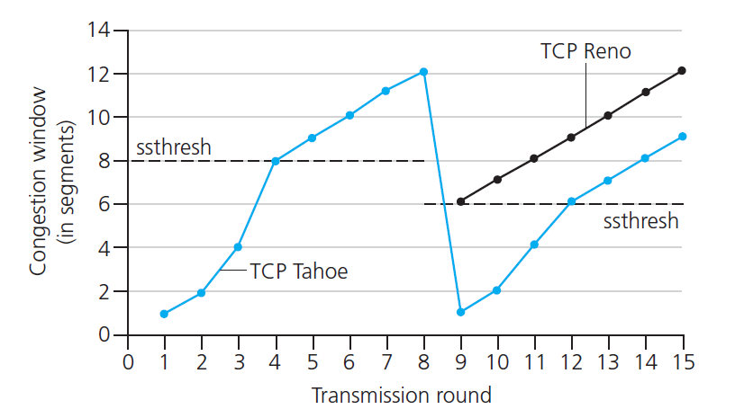

TCP: from slow start to congestion avoidance
Q: when should the exponential increase switch to linear?
A: when cwnd gets to 1/2 of its value before timeout.
X
MSS = 8
Implementation:
variable ssthresh
on loss event, ssthresh is set to 1/2 of cwnd just before loss event
Note: The congestion window is 12 • MSS when this loss event occurs
ssthresh = 0.5 • cwnd = 6 • MSS (TCP Tahoe)
* Check out the online interactive exercises for more examples: http://gaia.cs.umass.edu/kurose_ross/interactive/

Slide 28

Summary: TCP Congestion Control
New
ACK!
New
ACK!
.
duplicate ACK
new ACK
dupACKcount++
new ACK
cwnd = cwnd + MSS (MSS/cwnd)
dupACKcount = 0
transmit new segment(s), as allowed
cwnd = cwnd+MSS
dupACKcount = 0
transmit new segment(s), as allowed
Λ
cwnd = 1 MSS
ssthresh = 64 KB
dupACKcount = 0
cwnd > ssthresh
slow
start
Λ
congestion
avoidance
timeout
ssthresh = cwnd/2
cwnd = 1 MSS
dupACKcount = 0
retransmit missing segment
duplicate ACK
timeout
dupACKcount++
ssthresh = cwnd/2
cwnd = 1 MSS
dupACKcount = 0
retransmit missing segment
timeout
New
ACK!
ssthresh = cwnd/2
cwnd = 1
dupACKcount = 0
retransmit missing segment
New ACK
dupACKcount == 3
cwnd = ssthresh
dupACKcount = 0
dupACKcount == 3
ssthresh= cwnd/2
cwnd = ssthresh + 3
retransmit missing segment
ssthresh= cwnd/2
cwnd = ssthresh + 3
retransmit missing segment
fast
recovery
duplicate ACK
cwnd = cwnd + MSS
transmit new segment(s), as allowed

Slide 29
TCP throughput
avg. TCP thruput as function of window size, RTT?
  ignore slow start, assume always data to send
W: window size (measured in bytes) where loss occurs
  avg. window size (# in-flight bytes) is ¾ W
  avg. thruput is 3/4W per RTT
3
W
avg TCP thruput =
RTT
bytes/sec
4
W
W
bytes/sec
0.75
RTT
W/2

Slide 30
TCP Futures: TCP over “long, fat pipes”
example: 1500 byte segments, 100ms RTT, want 10 Gbps throughput
requires W = 83,333 in-flight segments
throughput in terms of segment loss probability, L (Loss Rate) [Mathis 1997]:
  ➜ to achieve 10 Gbps throughput, need a loss rate of L = 2·10⁻¹⁰ – a very small loss rate!
new versions of TCP for high-speed
.
1.22
MSS
TCP throughput =
RTT
L

Slide 31
A TCP Reno connection operates with the following parameters: MSS is 1000 bytes, RTT is 50 ms, and Packet loss probability (L) is 0.0009. Assuming the standard TCP Reno throughput approximation model, calculate the expected throughput of the connection in: a) Bytes per second b) Mbps

Slide 32

TCP Fairness
fairness goal: if K TCP sessions share same bottleneck link of
bandwidth R, each should have average rate of R/K
TCP connection 1
bottleneck
router
capacity R
TCP connection 2

Slide 33
Why is TCP fair?
two competing sessions:
additive increase gives slope of 1, as throughout increases
multiplicative decrease decreases throughput proportionally
R
equal bandwidth share
loss: decrease window by factor of 2
congestion avoidance: additive increase
Connection 2 throughput
loss: decrease window by factor of 2
congestion avoidance: additive increase
Connection 1 throughput
R

Slide 34
Fairness (more)
Fairness and UDP
multimedia apps often do not use TCP
  do not want rate throttled by congestion control
instead use UDP:
  send audio/video at constant rate, tolerate packet loss
Fairness, parallel TCP connections
application can open multiple parallel connections between two hosts
web browsers do this
e.g., link of rate R with 9 existing connections:
  new app asks for 1 TCP, gets rate R/10 (fair)
  new app asks for 11 TCPs, gets R/2 (unfair)

Slide 35

Explicit Congestion Notification (ECN)
network-assisted congestion control:
two bits in IP header (ToS field) marked by network router to indicate congestion
congestion indication carried to receiving host
receiver (seeing congestion indication in IP datagram) ) sets ECE bit on receiver-to-sender ACK segment to notify sender of congestion
source
TCP ACK segment
destination
application
transport
network
link
physical
ECE=1
application
transport
network
link
physical
ECN=00
ECN=11
IP datagram

Slide 36
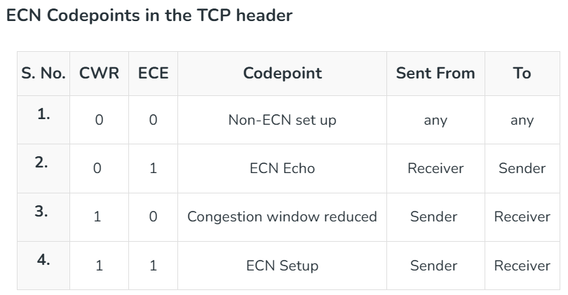
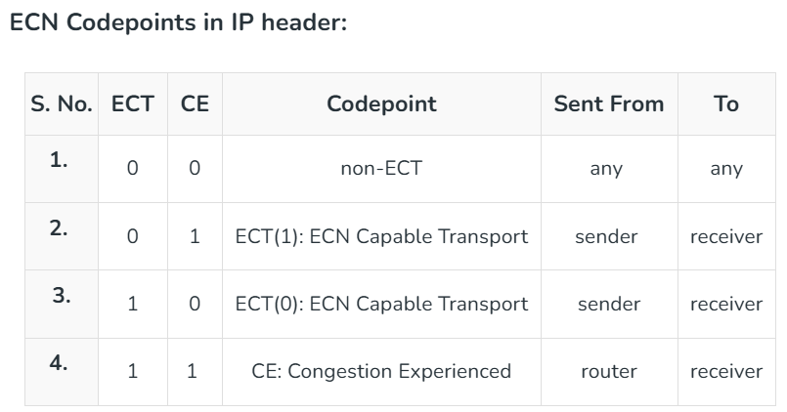
Explicit Congestion Notification (ECN)
CWR: Congestion Window Reduced Flag
ECE: ECE Echo
ECT: ECN Capable Transport
CE: Congestion Experienced
source
TCP ACK segment
destination
application
transport
network
link
physical
ECE=1
application
transport
network
link
physical
ECN=00
ECN=11
IP datagram

Slide 37
Thank You!

Slide 38
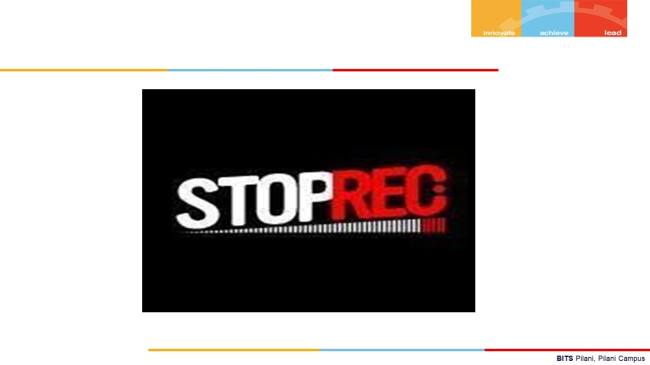
END the session before leaving

